Slide 1
BDA 102 - Big Data Analytics
Week 12

Slide 2

Learning Objectives
Introduction to the Cloud technologies

Slide 3
Challenge
“By 2020, some 50 billion smart
devices will be connected, along with
additional billions of smart sensors,
ensuring that the global supply of data
will continue to more than double
every two years”
… and only about 1% of the data generated today is actually analyzed

Slide 4
Cloud Computing
Cloud computing is a model for enabling cost effective business outcomes through the use of shared application and computing services.

Slide 5
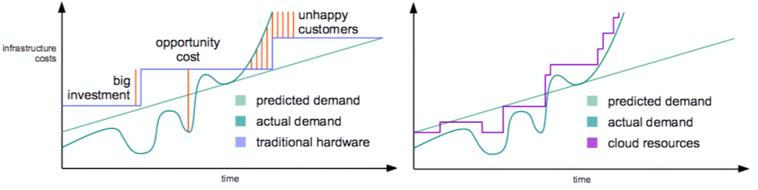
Cloud computing benefits
Cost: On-demand ; pay as you go
Speed
Global scale: scale up across the globe.
Focus on rapid innovation
Productivity enhancement
Vertically and horizontally stacks
Enhance functionality
Performance,
Reliability,
Fault tolerance and security

Slide 6
Cloud technology enablers
Cloud access devices (advances in processors)
Browsers and thin clients
Broadband internet connection
Fast inexpensive servers
Virtualisation technology
API

Slide 7
What is a Container?
VM
VM
VM
VM
App A
App A
App B
Container
Container
Container
App A
App B
App C
Guest OS
Guest OS
Guest OS
Bins/Libs
Bins/Libs
Bins/Libs
Container Engine
Guest OS
Hypervisor
Hypervisor
Host OS
Host OS
Server
Server
Notes:
Containers—greater density, consistent way to package and deliver apps with minimal code changes
VMs virtualize HW creating illusion of VMs each having their own guest OS
Containers virtualize OS. Share OS and create an isolated instance of the OS for each application
Faster app start up compared to booting up a VM

Slide 8
Deployment Models
Public cloud
Service provider makes resources, such as applications and storage, available to the general public over the Internet.
Public cloud services may be free or offered on a pay-per-usage model. Example: email
Community cloud
Shares infrastructure between several organizations from a specific community with common concerns (security, compliance, jurisdiction, etc.), whether managed internally or by a third-party and hosted internally or externally.
The costs are spread over fewer users than a public cloud , only some of the cost savings potential of cloud computing are realized.
Hybrid cloud
Composition of two or more clouds (private, community or public) that remain unique entities but are bound together.
It can also be defined as multiple cloud systems that are connected in a way that allows programs and data to be moved easily from one deployment system to another.
Private cloud
Private cloud is infrastructure operated solely for a single organization, whether managed internally or by a third-party and hosted internally or externally,
https://www.youtube.com/watch?v=3WIJ4axzFlU

Slide 9
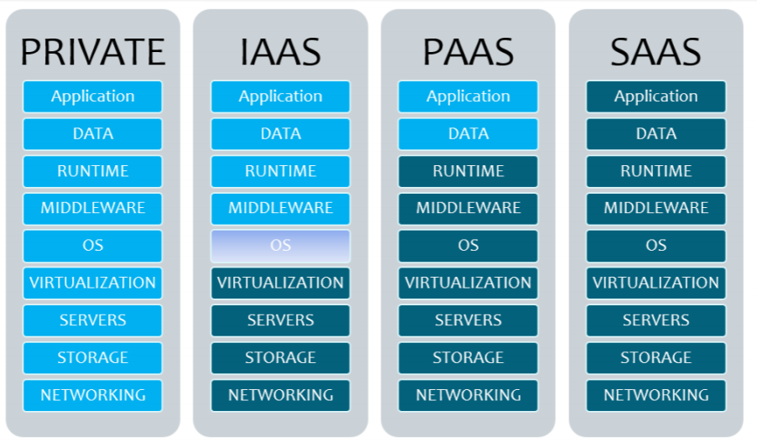
Service models
It refers the degree of involvement between cloud and the clients
IaaS (Infrastructure as a Service): Amazon EC2
PaaS (Platform as a Service): Google App engine, Force.com
SaaS (Software as a Service): email, CRM
Faas (Function as a Service): Alexa
Daas (Function as a Service): Data lake
https://www.youtube.com/watch?v=36zducUX16w

Slide 10
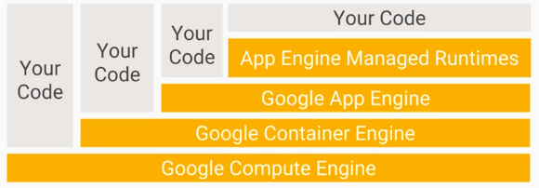
Service models
https://www.youtube.com/watch?v=36zducUX16w

Slide 11
Cloud Computing Service Layers
Services
Description
Services
Services – Complete business services such as PayPal, OpenID, OAuth, Google Maps, Alexa
Application
Focused
Application
Application – Cloud based software that eliminates the need for local installation such as Google Apps, Microsoft Online
Development
Development – Software development platforms used to build custom cloud based applications (PAAS & SAAS) such as SalesForce
Platform
Platform – Cloud based platforms, typically provided using virtualization, such as Amazon ECC, Sun Grid
Storage
Infrastructure
Focused
Storage – Data storage or cloud based NAS such as CTERA, iDisk, CloudNAS
Hosting
Hosting – Physical data centers such as those run by IBM, HP, NaviSite, etc.

Slide 12
Cloud leaders
Amazon Web Services (AWS)
the oldest and most experienced player on the market
established at the beginning of 2006
AWS has an extensive list of computing services with functions of deployment, mobile networking, and others.
Google Cloud Platform (GCP)
Started on October 6. 2011.
Initially, the push was done to strengthen their own services such as Google or YouTube. But they went further and created enterprise services
Microsoft Azure
Presented in February 2010
This platform can easily be associated with AWS – both of them provide their custom with a full set of services.
https://www.upwork.com/hiring/for-clients/aws-vs-azure-vs-google-cloud-platform-comparison/

Slide 13
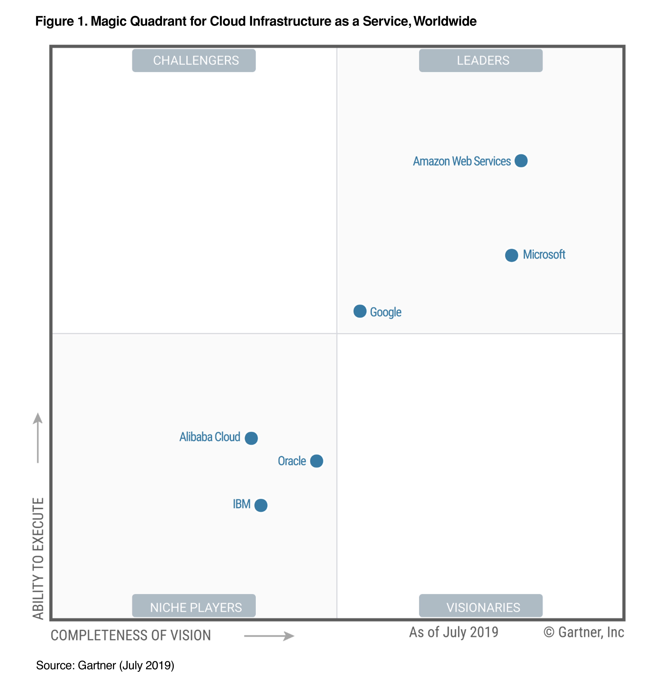
Cloud leaders

Slide 14
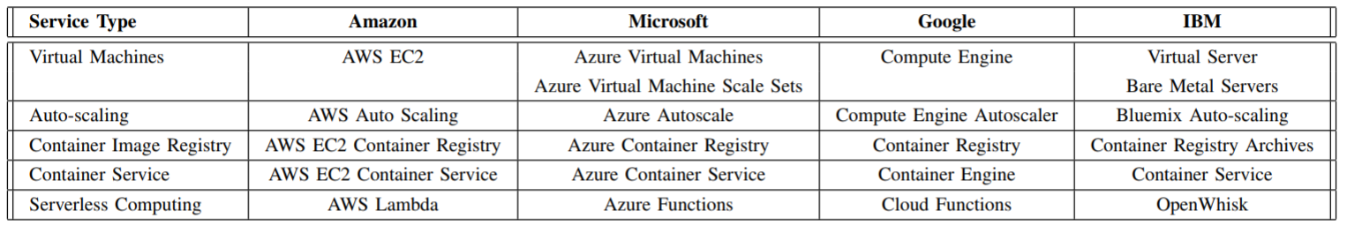
Cloud comparison areas
Compute Services
Storage Services
Databases
Big Data and Analytics
Data Pipelines
Machine Learning and AI
Networking and Content Delivery

Slide 15
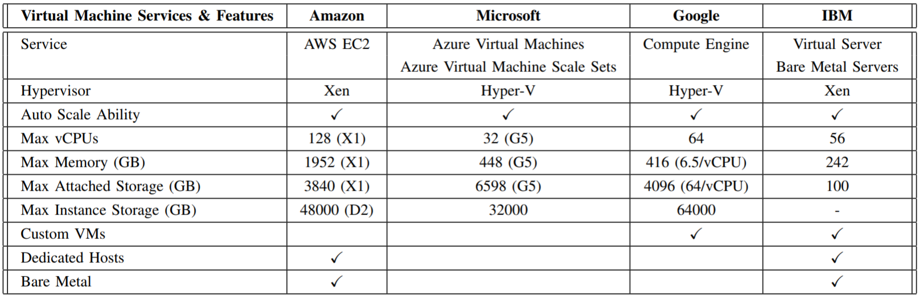
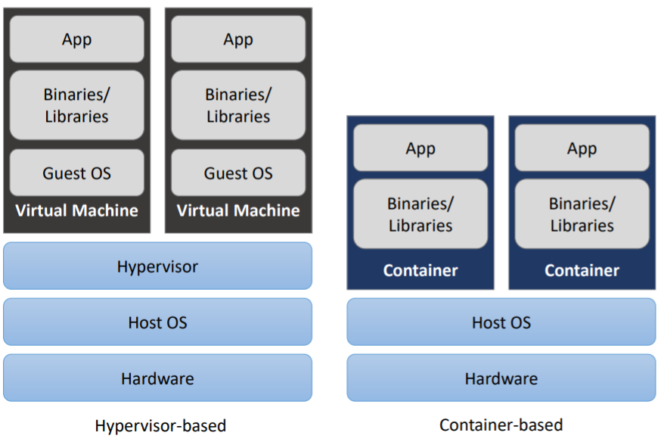
Virtual Machines

Slide 16
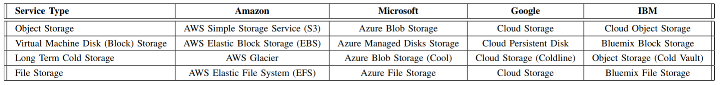
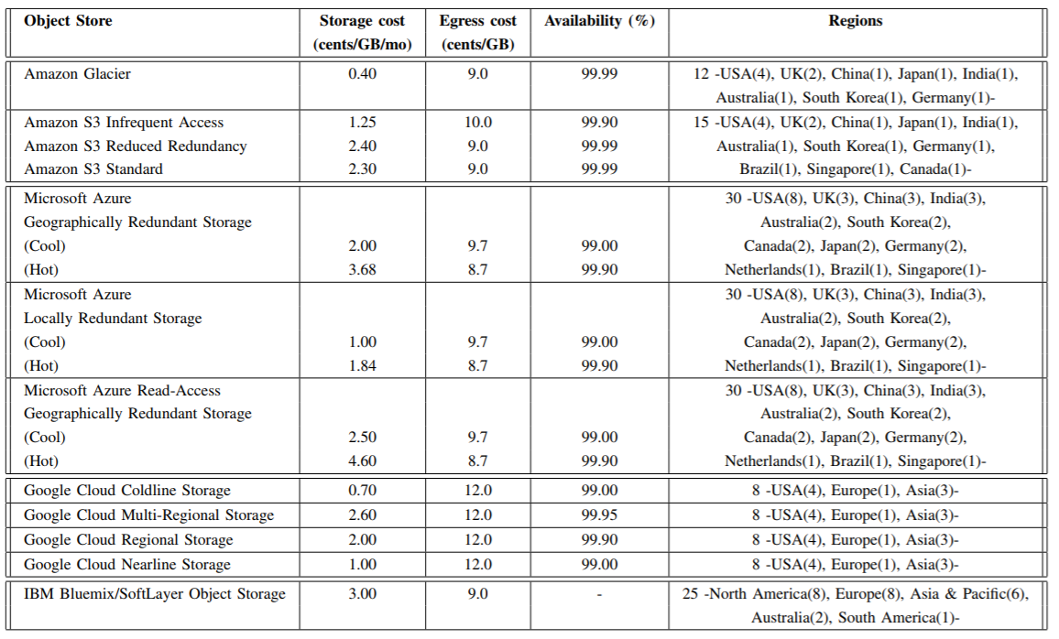
Storage

Slide 17
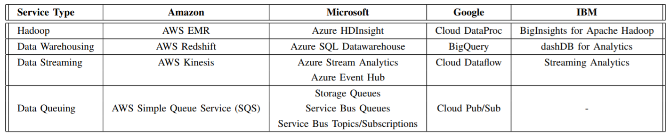
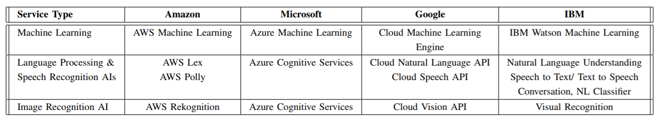
Big data Analytics
https://arxiv.org/pdf/1710.01476.pdf

Slide 18
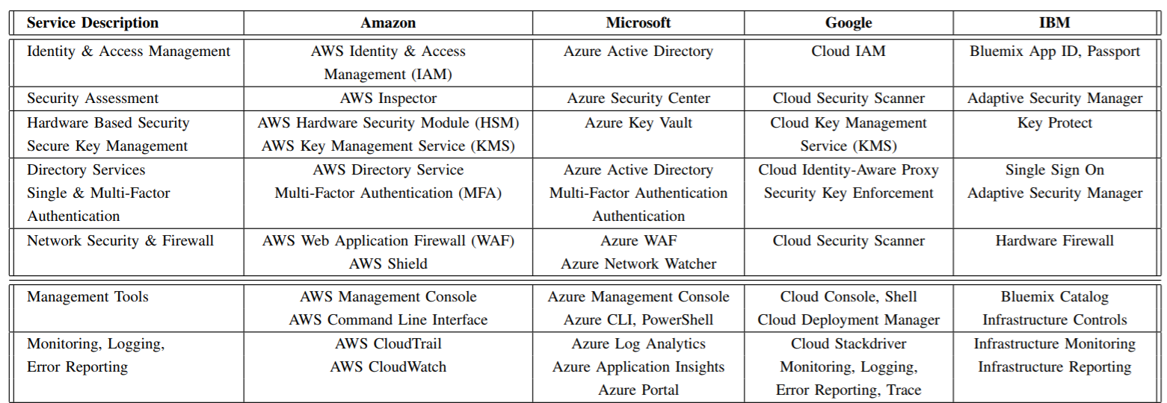
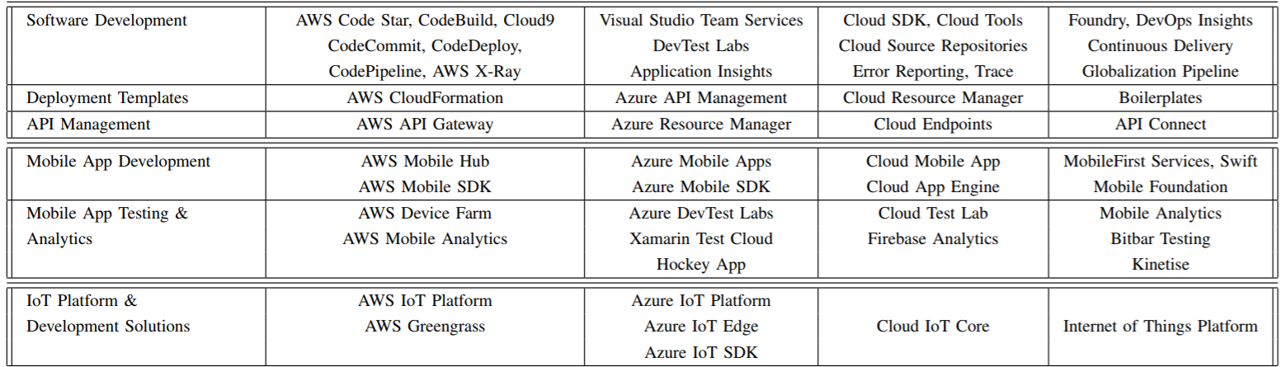
Additional services

Slide 19
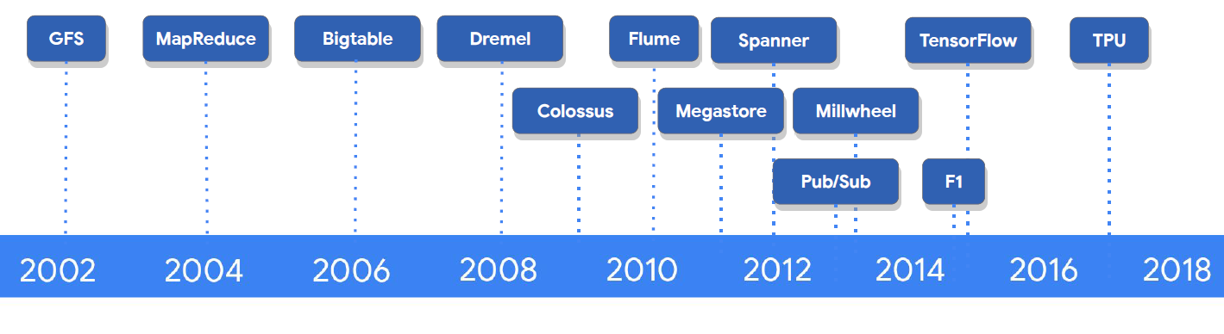
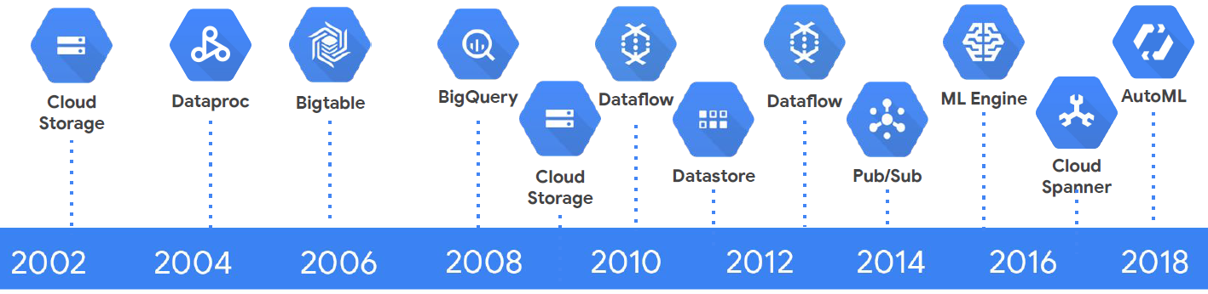
Google time line

Slide 20
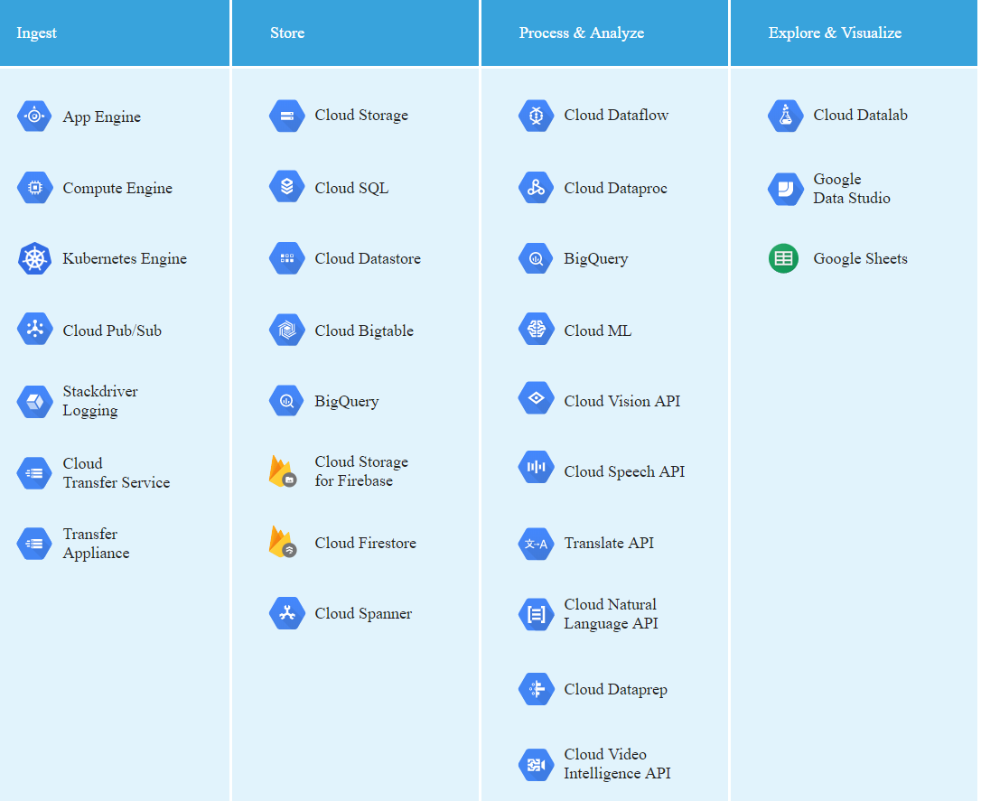
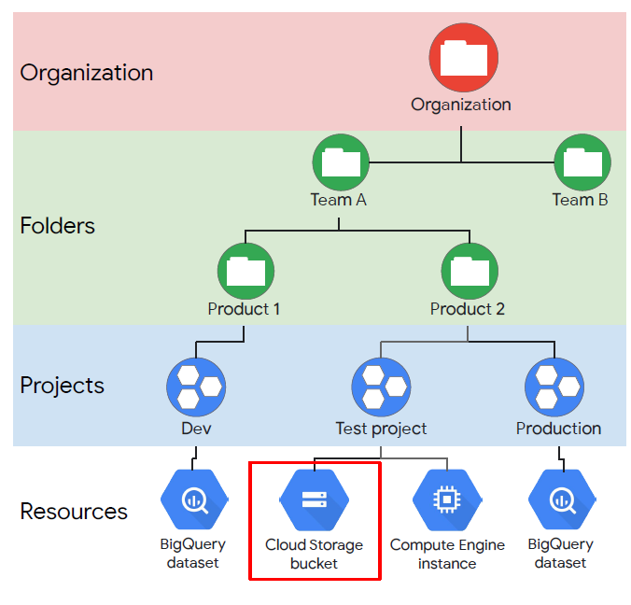
Google Cloud Platform at a glance

Slide 21
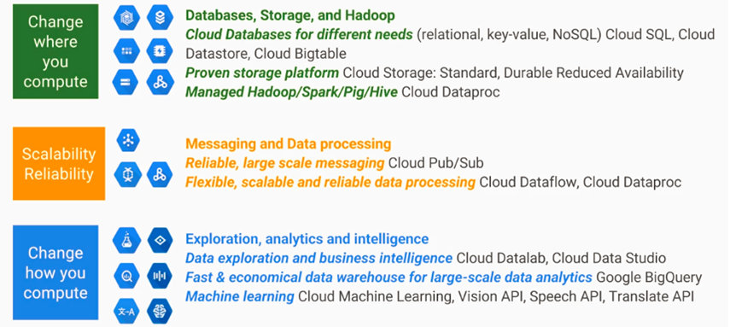
Google cloud big Data Platform

Slide 22
Google cloud resources
Cloud Datastore: https://cloud.google.com/datastore/
Cloud Bigtable: https://cloud.google.com/bigtable/
Google BigQuery: https://cloud.google.com/bigquery/
Cloud Datalab: https://cloud.google.com/datalab/
TensorFlow: https://www.tensorflow.org/
Cloud Machine Learning: https://cloud.google.com/ml/
Vision API: https://cloud.google.com/vision/
Translate API: https://cloud.google.com/translate/
Speech API: https://cloud.google.com/speech/

Slide 23
https://cloud.google.com/free/
$300 credit for 12 months
Trial ends when either credit is used up, or 12 months pass, whichever comes first
Requires credit card for trial, but does not auto-charge when trial runs out
When upgrading to full account, free credit/time still remains and will be auto-charged after credit runs out
Trial limitations
Compute Engine
No more than 8 cores running at once (across all instances)
No more than 100GB solid state disk (SSD) space
2TB persistent standard disk space

Slide 24
AWS
Compute
EC2: virtual machines inside the platform
EC2 container: to contain a service (for running a docker container)
Elastic Beanstalk: to just upload the code and the rest on AWS
Lambda: function as a service
- Lightsail: Amazon’s VPN service or virtual private service. Provision a server and you will get a fixed IP address.
Batch: used for batch computing
Storage:
S3 : Simple storage service
EFS: Elastic file system (mount EFS file store to multiple virtual machine)
Glacier: back up
Snowball
Storage Gateway

Slide 25
AWS –cont.
Databases:
RDS : relational database service
DynamoDB: None relational database.
Elasticache: for caching.
Redshift: data warehousing
Migration:
AWS Migration Hub: a tracking service allows to track your application as you migrate them.
Application discovery service: an automated t of tools for detecting the application and dependencies.
Database migration service: to migrate your databases from on-premise into AWS
Server migration service: helping to migrate your virtual and physical servers into AWS
Snowball.

Slide 26
AWS- cont.
Networking and content delivery
VPC
CloudFront: amazon’s content delivery network (your video or media or image files).
Route 53- Amazon’s DNS
API gateway: a way to create your own APIs.
Direct Connect : running a dedicated line from on-premise to AWS.
Developer tools:
CodeStar: a way of getting a group of developers working together (code project management)
Code commit: store code.
Code build: build and test code.
CodeDeploy
Code pipeline: a continuous delivery service and use that sort of model and visualize and automate.
X-ray: to debug and analyse your service applications.
Cloud 9: ideal environment for developing code inside the AWS consol.

Slide 27
AWS-cont.
Management tools:
CloudWatch: monitoring service
CloudFormation: a way of scripting infrastructure
CloudTrial: to log changes to your AWS environment.
Config: Monitors the configuration of your entire AWS environment and it has like point in time snapshot.
OpsWork: similar to Beanstalk using chef and puppet for automating and configuration of environment.
Service catalog: for governance and compliance services requirements.
System manager: an interface for managing your AWS resources.
Trusted advisor
Managed services
Media Services:
Elastic Transcoder
Media converter- file based video transcoding service with broadcast grade features.
MediaLive- broadcast alive video processing (create video streaming to deliver to broadcast TVs,…)
MediaPackage: prepare and protect videos for delivery over the internet.
MediaStore: to store your media.
MediaTailor: for advertising into video streaming.

Slide 28
AWS – cont.
Machine learning:
SageMaker: for deep learning.
Comprehend: sentiment analytics.
DeepLens: web camera.
Lex: it powers Amazon Alexa, it is a way of communicating the customers (chatting).
Machine learning
Polly: text to speech.
Rekognition: recognition of video and image.
Amazon translates.
Amazon transcript.
Analytic
Athena
ClouSearch
ElasticSearch
EMR
Kinesis
Kinesis video streaming (social media, …)
Business intelligence tool.
Data Pipeline: data movement
Glue: ETAL tools

Slide 29
AWS- cont
Mobile services:
Mobile hub
Pinpoint (Push notification)
AWS AppSync
Device Farm (testing)
Mobil analytics.
AR/VR
Application integration:
Step function: to manage your different Lambda functions.
Amazon MQ: to do massage Queue.
SNS: notification service e.g. billing alarm
SQS: for decoupling infrastructure.
SWF: simple workflow service.
Customer engagement:
Amazon Connect:
Amazon Simple email service

Slide 30
AWS- cont.
Business productivity:
Alexa for business; dial to meeting room
Chime: like google hangout or zoom meeting, record meeting
Work Docs: like dropbox for work related documents
WorkMail: like Microsoft office 365.
Deskop and app streaming:
workspaces
appSream 2.0
IOT
Iot
IoT Device management
Amazon FreeRTOS
Greengrass
Game development:
gameLift

Slide 31
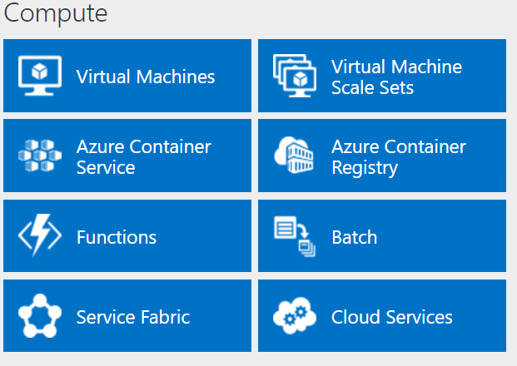
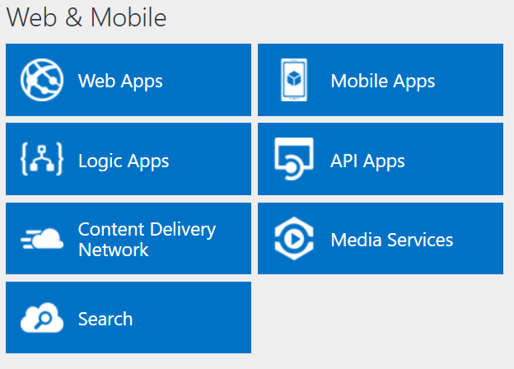
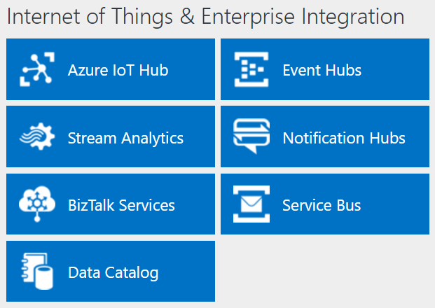
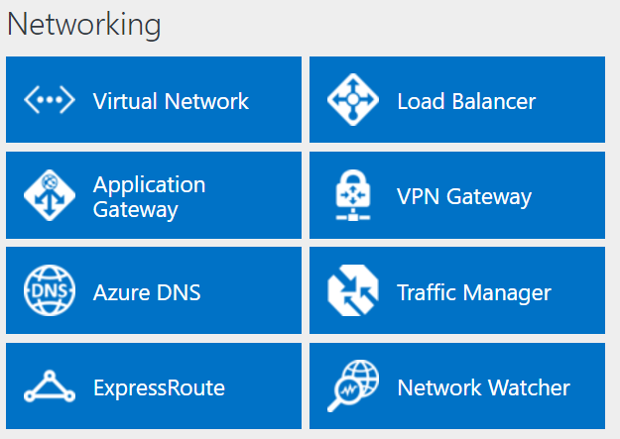
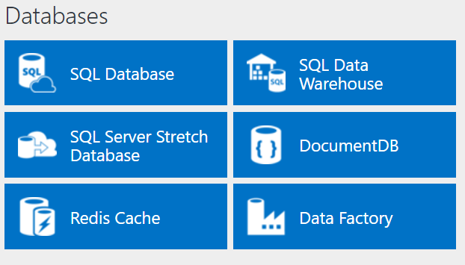
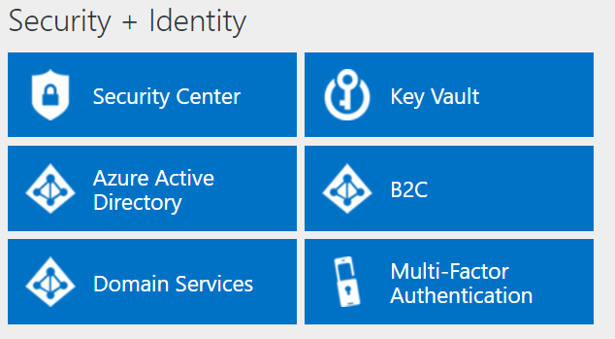
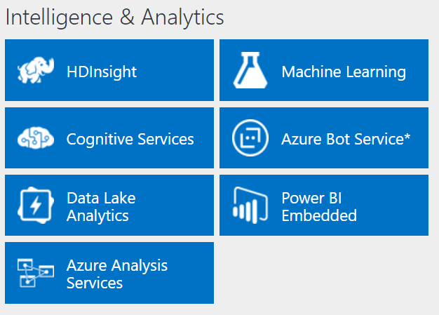
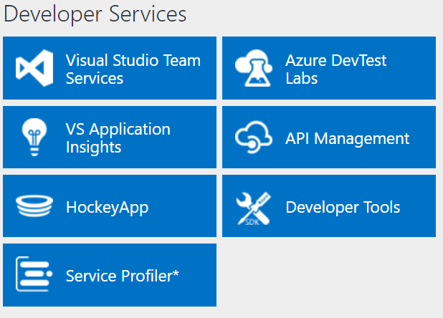
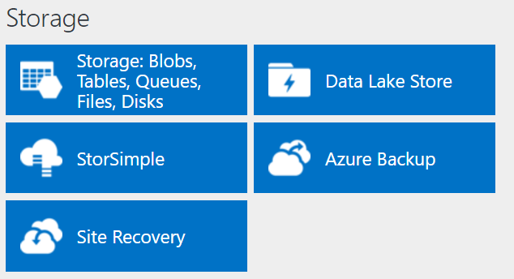
http://azureplatform.azurewebsites.net/

Slide 32
Compute
IaaS VMs
VM Scale Sets
Batch
Logic Apps
Functions
App Service
Azure Container Service
Azure Container Instances
Service Fabric
Cloud Services
SERVERS!
SERVERLESS!
https://aka.ms/comparecompute

Slide 33
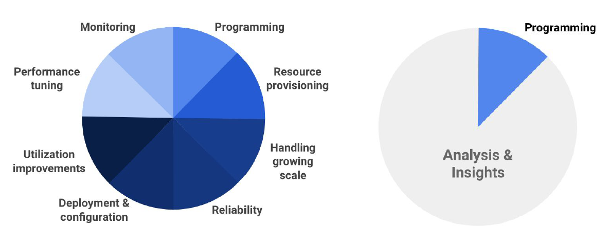
serverless
Signs that a serverless pattern might be useful for a given scenario
Stateless → Scale
Not worth deploying a traditional backend
Workload is sporadic (very low & high scale)
Dev ops favored versus dedicated ops
Lots of different services involved that need “glue”

Slide 34
Summarizing the options
Service | Best used for…
VMs | Lift-and-shift for a set of “pets”
VM Scale Sets | Scaling and managing a set of identical VMs
Batch | Highly parallelized computation
Container Service | Deploying and managing a set of arbitrary Linux containers
Container Instances | Running individual containers with low overhead and no VM management
Service Fabric | Building microservice-based applications on Windows using .NET
App Service | Building standard web and mobile apps with limited management responsibilities
Functions | Building small, event-driven software with granular auto-scale

Slide 35
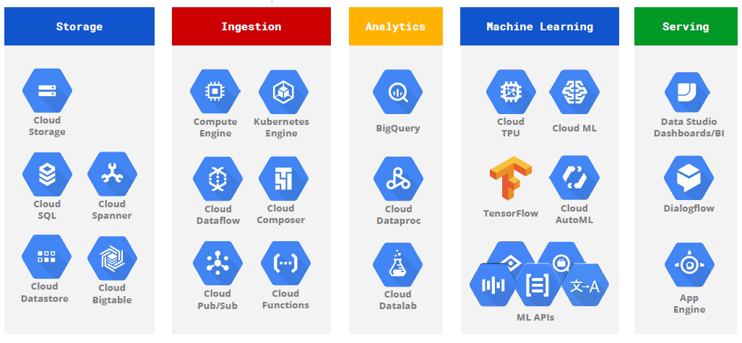
big data products

Slide 36
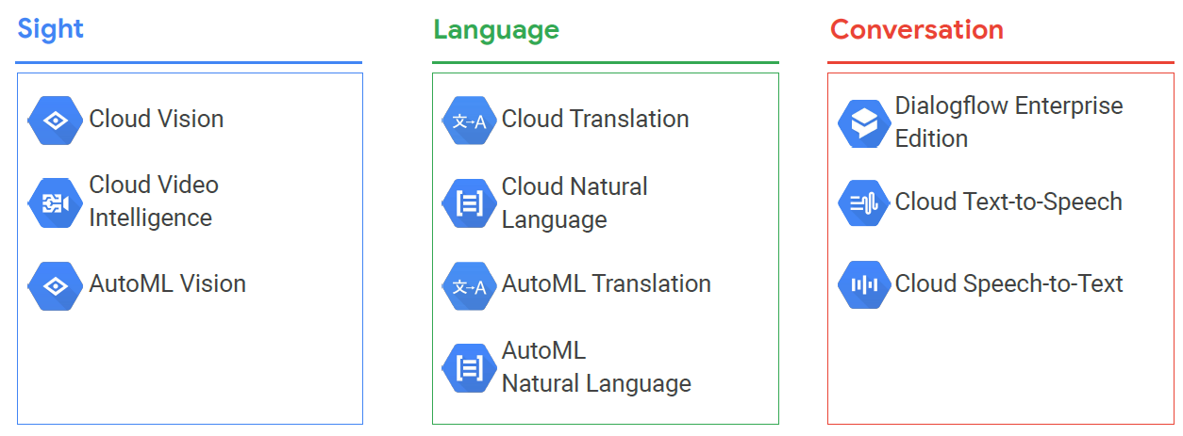
Google’s AI research

Slide 37
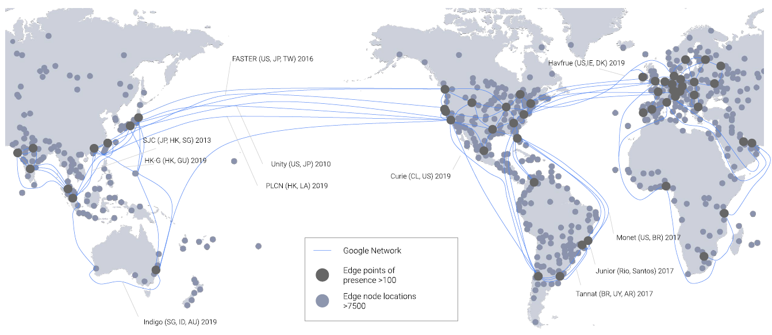
Google’s cable network

Slide 38
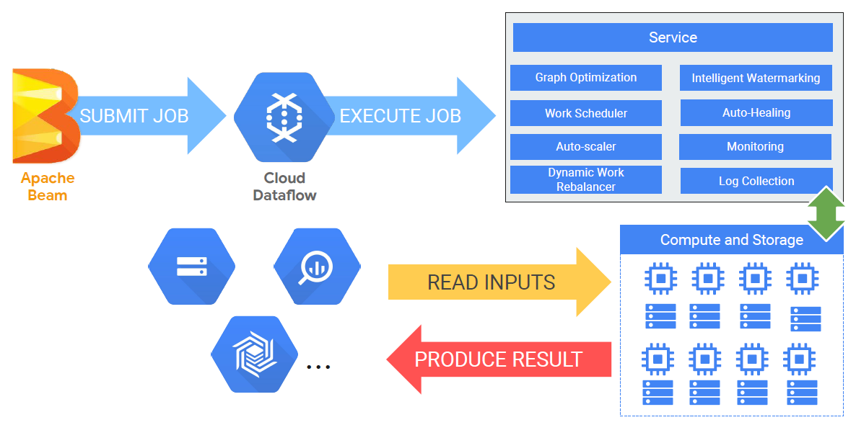
DataFlow
Serverless, fully managed data processing
Unified batch and streaming processing + autoscale

Slide 39
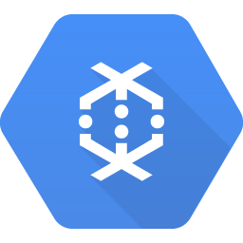
DataFlow
Fully-managed service for transforming and enriching data in stream and batch
Simplified reusable pipeline based on Apache Beam which provides a rich set of windowing and session analysis primitives as well as an ecosystem of source and sink connectors.
Seamlessly integrates with GCP services like Pub/Sub, BigQuery, machine learning (Cloud Machine Learning), and more.
Lets developers build custom extensions and even choose alternative execution engines, such as Apache Spark via Cloud Dataproc or on-premises.
Supports pipeline portability across Cloud Dataflow, Apache Spark, and Apache Flink as runtimes
For Apache Kafka users, a Cloud Dataflow connector makes integration with GCP easy.

Slide 40
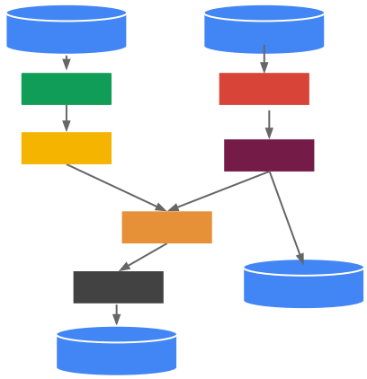
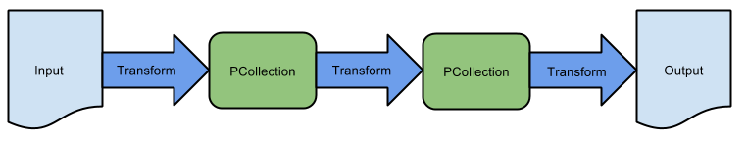
Terminologies
Pipeline: A Pipeline encapsulates the entire data processing task; input data, transformation, writing output and the execution options that tell the Pipeline where and how to run. It’s directed graph of data processing transformations
PCollection: A PCollection represents a distributed data set that the pipeline operates on. The data set can be
bounded, meaning it comes from a fixed source like a file,
unbounded, meaning it comes from a continuously updating source via a subscription or other mechanism.
PTransform: A PTransform represents a data processing operation, or a step, in the pipeline. Every PTransform takes one or more PCollection objects as input, performs a processing function that you provide on the elements of that PCollection, and produces zero or more output PCollection objects.
I/O transforms: “IOs” - library PTransforms that read or write data to various external storage systems.

Slide 41
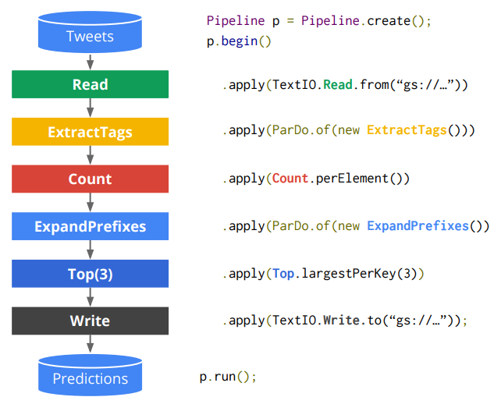
Runners
Specify how a pipeline should run
Direct Runner
For local, in-memory execution. Great for developing and unit tests
Cloud Dataflow Service
batch mode: GCE instances poll for work items to execute.
streaming mode: GCE instances are set up in a semi-permanent topology
Example: tweeter

Slide 42
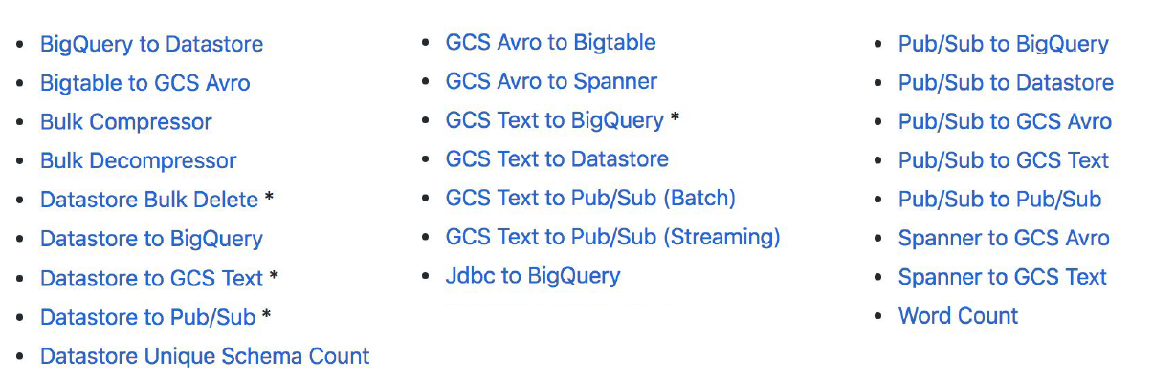
Data flow templates
http://github.com/GoogleCloudPlatform/DataflowTemplates

Slide 43
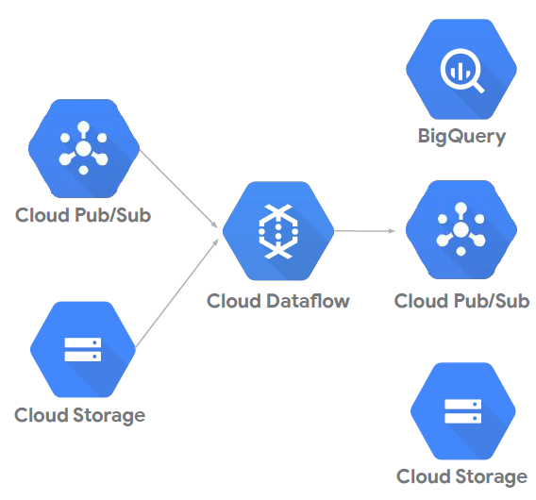
real-time and batch

Slide 44
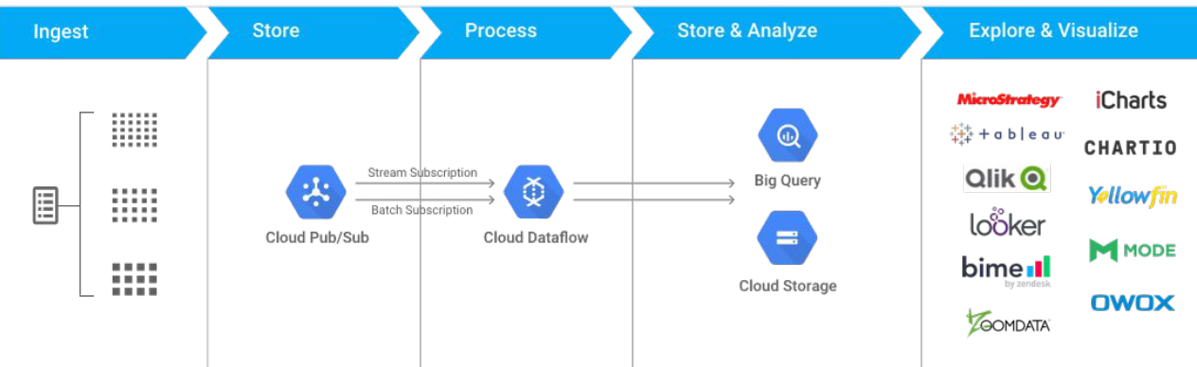
Big data pipeline

Slide 45
Big Query
Big query is Google's enterprise data warehouse offering
Convenience of Standard SQL
Fully managed and serverless
Storing, compression, encryption, replication, performance tuning, and scaling.
Petabyte scale storage and queries
Real-time analytics on streaming data
BigQuery is not
a polished set of reports.
There are no reporting capabilities built directly into BigQuery.
a traditional relational database.
BigQuery is optimized to operate over large, distributed data sets, and its structure can include nesting and repeating values. Because of this, the BigQuery query language is “SQL-like” but does not conform in all ways to the SQL standard.
Data in BigQuery tables cannot be changed or updated; a table may only be appended to.
Creating and updating tables and adding data to existing tables is accomplished via API calls rather than SQL commands.

Slide 46
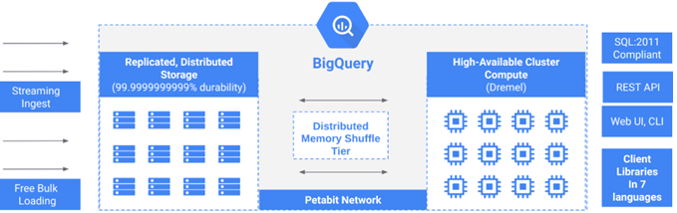
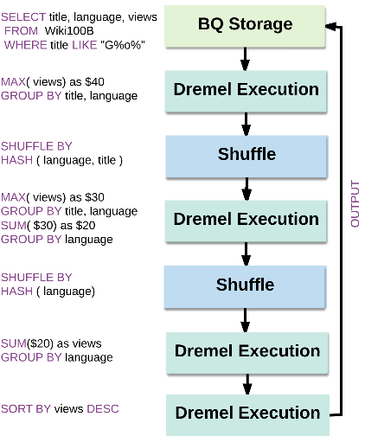
BigQuery and Its Components
1. Opinionated Storage Engine
2. Jupiter Network: Internal data center network that allows BigQuery to separate storage and compute.
3. Standard SQL and Dremel Execution Engine: Allows smart scheduling and pipeline execution.
4. Federated Query Engine: If the data is in GCS, Google Drive or Bigtable, you can query data from BigQuery with no data movement.
5. IAM, Audit Logs and Authentication: OAuth and Service Accounts are the two modes of authentication used for access controls.
6. UX, CLI, SDK, ODBC/JDBC, and API Access pattern

Slide 47
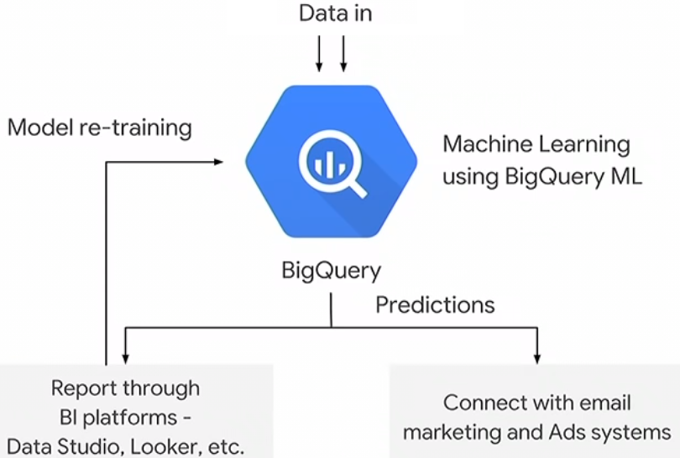
BigQuery features
Real-Time Analytics
High Availability
Standard SQL
Serverless
Locality
Security
Data Transfer Service
Automatic Backup
Big Data Ecosystem Integration
Cost Control
Integrate with TensorFlow and CloudML
Data Ingestion
REST API Interaction
No distribution or sort keys
Caching

Slide 48
BigQuery hierarchy
BigQuery stores data using the following hierarchy of containers:
Projects:
Top-level containers; holding resources and user data, store information such as billing data and authorized users.
Datasets:
BigQuery–specific data containers under projects.
Every table must live inside a dataset. A dataset is assigned to a single project. In addition, datasets let you control access to tables by using access control lists (ACLs).
Tables:
Tables contain the data in BigQuery, along with a corresponding table schema.
Each column of that data is stored separately.
The values in each column are compressed, run-length encoded, and encrypted, and the corresponding data file is replicated.
Each of these replicas is then stored in the underlying distributed filesystem, known as Colossus.
Tables are required in various data import scenarios: when data is loaded into a new table name in a dataset, when an existing table is copied into a new table name, and when running queries. BigQuery also supports views, which are virtual tables defined by a SQL query.
Big query Jobs: The associated actions of loading data, running queries, and exporting information

Slide 49
BigQuery’s query language
A query is a statement of the desired results from the dataset that can include the following clauses:
SELECT some fields FROM some tables WHERE the record is interesting GROUP BY some field I want to be unique HAVING some aggregate I find interesting ORDER BY some fields LIMIT to the top so many
BigQuery data types:
STRING: 64KB UTF-8 encoded string.
INTEGER: 64-bit signed integer.
FLOAT: Double-precision floating-point format.
BOOLEAN: True or false (case insensitive), or 1 or 0.
TIMESTAMP: One of two formats—Unix timestamps or calendar date/times. BigQuery stores TIMESTAMP data internally as a Unix timestamp with microsecond precision.

Slide 50
Data access into BigQuery
You do not need to load data before running queries
Public data
Shared data
External data sources
Google drive
Google cloud storage
Cloud Bigtable
Stackdriver log files
You can load data:
From Google Cloud Storage
From other Google services, such as DoubleClick and Google AdWords
From a readable data source (such as your local machine)
By inserting individual records using streaming inserts
Using Data Manipulation Language (DML) statements to perform bulk inserts
Using a Google Cloud Dataflow pipeline to write data to BigQuery
You can load data into a new table or partition, you can append data to an existing table or partition, or you can overwrite a table or partition.

Slide 51
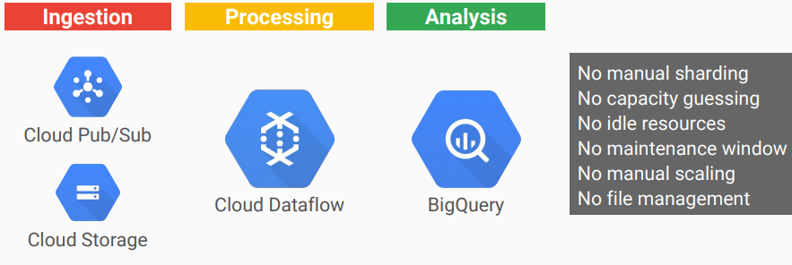
Serverless platform for all stages of the analytics data lifecycle

Slide 52
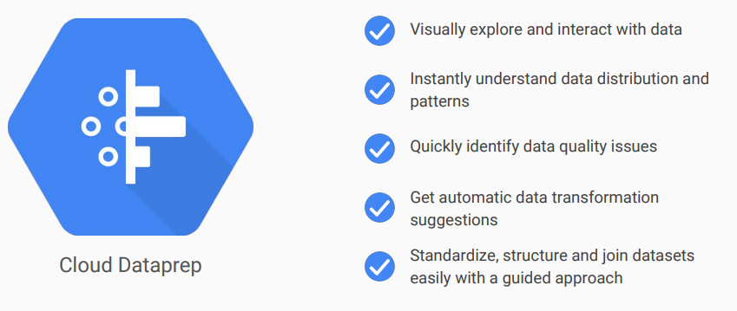
self-service data preparation

Slide 53
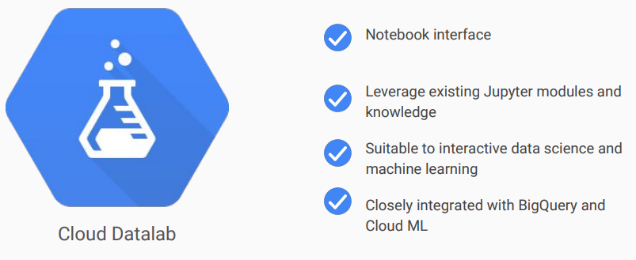
Data Exploration

Slide 54
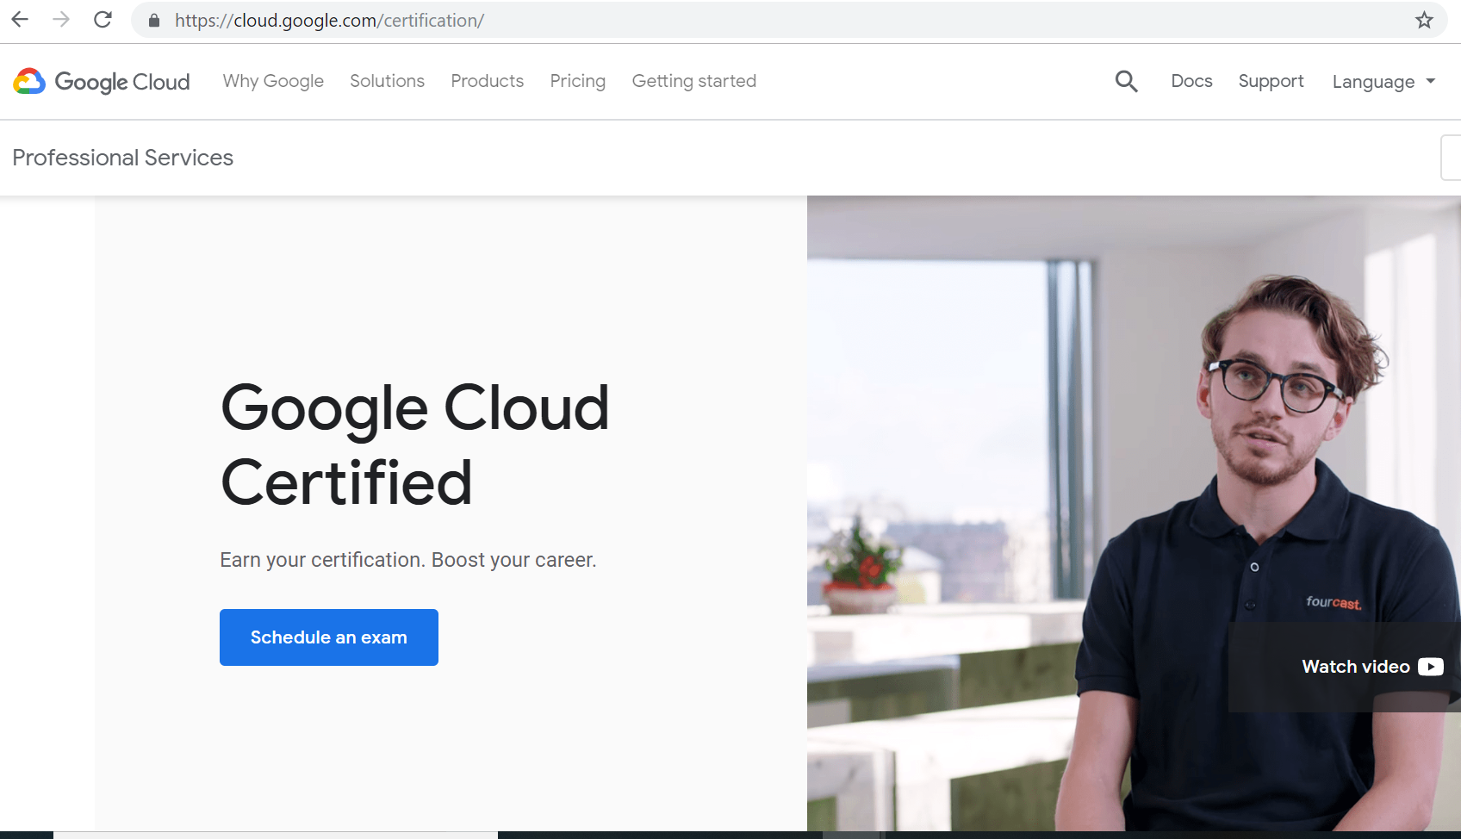
Google Cloud Certified
https://cloud.google.com/certification/

Slide 55
Thank You.

